Slide 1
The Morality and Ethics of Punishment in a Complex Society
The Mises Academy
The American Prison State: Lecture 7
Daniel J. D’Amico

Slide 2
The rationale of punishment: micro foundations and macro equilibrium
What behaviors should be subjected to punitive sanctions?
What are the appropriate intentions of punishment?
How are proportionate penalties calculated?
-all were topics of interest theoretically and empirically before the rise of state-monopoly criminal justice institutions.
-we didn’t have a criminal justice ethics informed by public finance theory mostly because we didn’t need one.

Slide 3
The political reality of punishment
Since the beginning of the 19th century and especially in the later half of the 20th, this philosophical and sociological project has presumed the legitimacy of the social contract.
This could be right or wrong but unfortunately it has avoided taking seriously the unique implications from public finance when applied to criminal justice ethics.

Slide 4
The economics of crime and punishment.
Requires sometimes unrealistic simplifying assumptions
Maximize deterrence by assuming a static, state-determined definition of crime and enforcement type.
Our model is geared to promote efficiency within a given fixed institutional context.

Slide 5
Institutional harmony

Slide 6
Institutional quality
Harmony between formal and informal leads to stability, general peace, economic prosperity, resilience and adaptability.
Disharmony
Severity of governmental law enforcement
Endogenous underground enforcement via secretive communication, violent reciprocity norms and cultural approbation.
Both effects have lead to serious social problems

Slide 7
This Fatal Conceit plays out similarly in various arenas.
The political economy arguments that legitimize centralized authority over law and order
The model of criminal rehabilitation
The initial explanation for prison riots
The role of incarceration in totalitarian regimes
The militarized retributive response to drug production and consumption
-the facts are in: it is difficult to plan to make people better

Slide 8
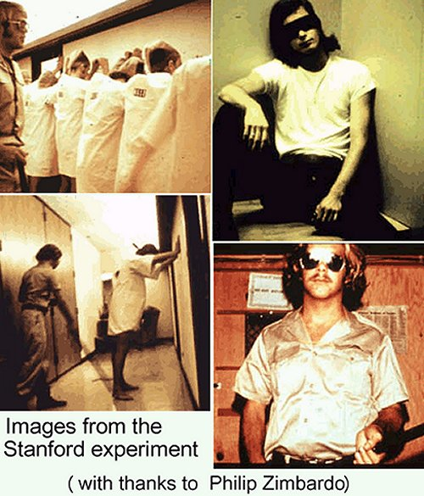
The range of social outcomes from applied plans: the good turn bad

Slide 9
The Bad Turn Good

Slide 10
Ethical support for constitutions over criminal prohibitions
Framing constitutions to protect the processes of institutional innovation may require explicitly constraining the ability of the state to produce and apply violence.
Statelessness research gives theory and description of institutional alternatives.

